Slide 1
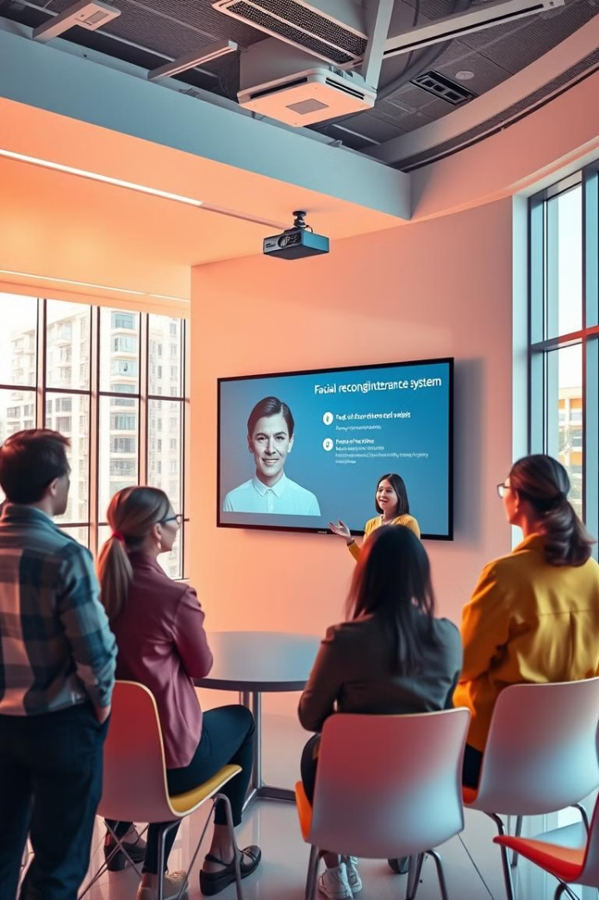

Introducing the Face Attendance System
Welcome to the cutting edge of attendance tracking! This presentation delves into the innovative Face Attendance System, designed to revolutionize how we manage attendance in the modern workplace. It leverages the power of Python, OpenCV, and NumPy to create a secure and efficient system that simplifies attendance management while enhancing accuracy and streamlining operations.
by Shiv shakti Mishra

Slide 2
Foundation: Python, OpenCV, and NumPy
The foundation of this system lies in the powerful trio of Python, OpenCV, and NumPy. Python, known for its readability and versatility, provides the core programming language. OpenCV, an open-source computer vision library, enables real-time face detection and recognition. NumPy, the numerical computing library for Python, facilitates efficient manipulation and analysis of attendance data.
Python
OpenCV
NumPy
Python's robust libraries, clear syntax, and vast community support make it ideal for developing complex applications like our face attendance system.
OpenCV's extensive functionalities for image and video processing are essential for face detection, recognition, and analysis within the system.
NumPy's ability to perform high-level mathematical operations on arrays is crucial for efficient data handling and analysis in the attendance system.

Slide 3

Recognizing Faces: The Key Component
The system's core functionality lies in its ability to detect and recognize faces. This process involves two key steps: face detection and face recognition.
1
Face Detection
OpenCV's pre-trained models are used to identify potential faces within an image or video stream. The system searches for specific features like eyes, nose, and mouth to locate faces.
2
Face Recognition
Once a face is detected, the system extracts unique features from it, such as the distance between facial features. This data is compared to a database of known faces to identify the individual.

Slide 4
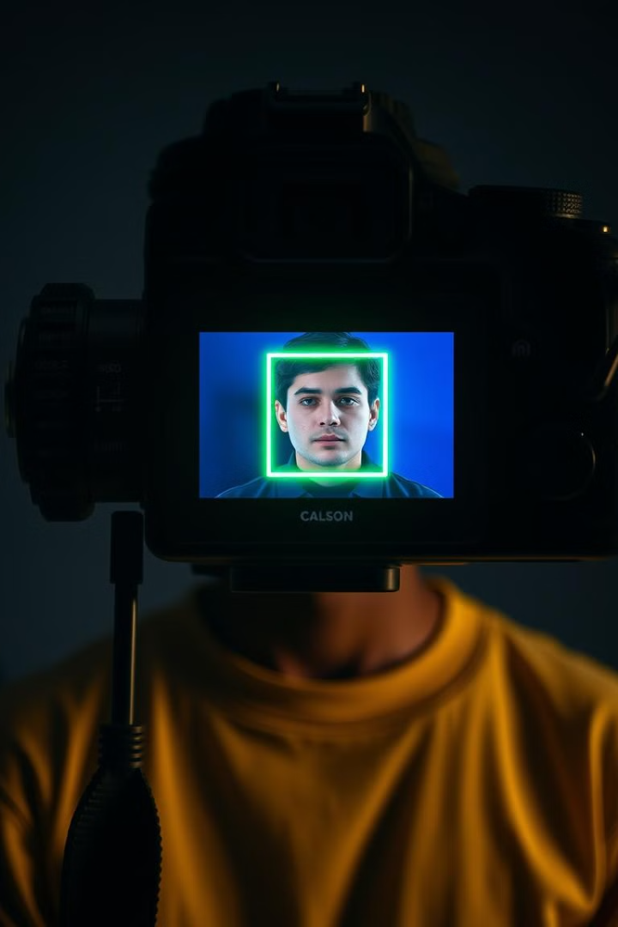
Capturing Attendance: Real-Time Efficiency
The Face Attendance System seamlessly captures attendance data in real time. The system uses a webcam or dedicated camera to capture live video feed. This live feed is continuously analyzed for faces, and the system registers the time and date when a recognized face enters or leaves a designated area. This eliminates the need for manual attendance marking and ensures accurate and up-to-date records.
1
Live Feed Analysis
2
Automatic Time Stamping
The system continuously analyzes the live video feed to detect and recognize faces, ensuring real-time attendance tracking.
When a recognized face is detected, the system automatically timestamps the entry or exit, eliminating manual data entry.
3
Designated Areas
The system can be configured to track attendance within specific areas, allowing for targeted attendance monitoring within different workspaces or departments.

Slide 5
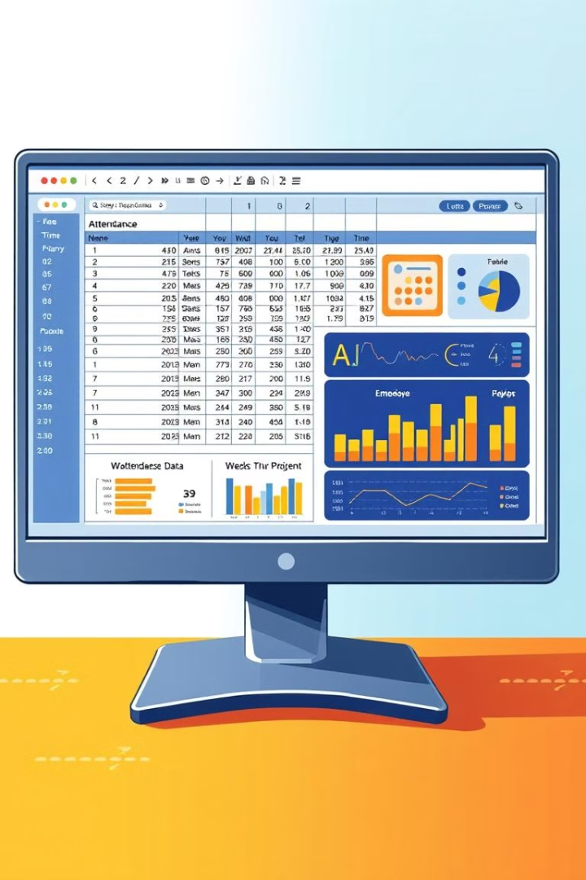
Data Storage: Secure and Organized
Ensuring the secure and organized storage of attendance data is paramount. The Face Attendance System stores attendance records in Comma Separated Value (CSV) files, a widely used and easily accessible format.
Employee ID
Name
Date
Time In
Time Out
12345
John Smith
2023-10-26
09:00 AM
05:00 PM
67890
Jane Doe
2023-10-26
09:15 AM
05:30 PM

Slide 6
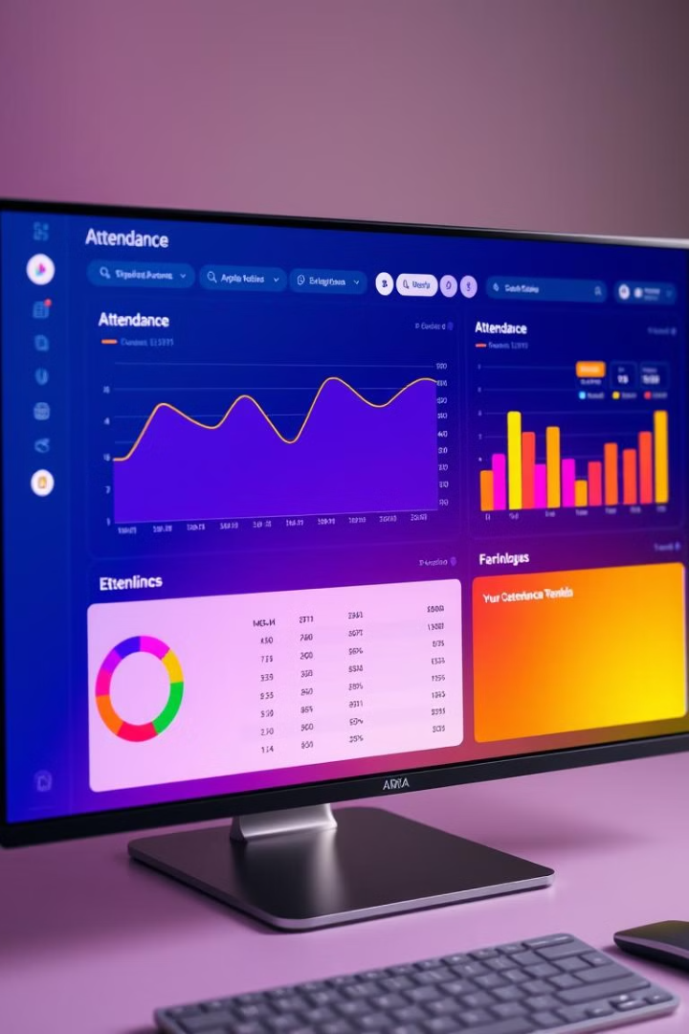



Visualizing Attendance Data: Gaining Insights
The Face Attendance System goes beyond simply capturing and storing attendance data; it enables insightful data visualization. The system can generate various charts and graphs from the stored CSV data to gain valuable insights into attendance patterns and trends. This information can be used to identify potential issues, optimize workforce planning, and improve overall efficiency.
Bar Charts
Visualize daily or weekly attendance patterns by comparing the number of employees present on different days.
Line Graphs
Show attendance trends over time, identifying any fluctuations or patterns in attendance.
Pie Charts
Represent the breakdown of attendance by different departments or teams within the organization.

Slide 7

Handling Exceptions: Ensuring Accuracy
While the Face Attendance System strives for accuracy, unforeseen circumstances might lead to exceptions. The system incorporates robust mechanisms to handle these exceptions and maintain data integrity.
Face Recognition Errors
System Downtime
In rare cases, the system might misidentify a person or fail to recognize a face. This could be due to poor lighting, changes in appearance, or obscured facial features. The system provides mechanisms to manually correct these errors, ensuring data accuracy.
In the event of a system outage, the system allows for manual attendance recording, ensuring uninterrupted data collection. This data can be later synchronized with the system once it's back online.
Data Integrity Checks
Regular data integrity checks are performed to ensure the consistency and accuracy of stored attendance records. Any inconsistencies are flagged and resolved, maintaining data quality.

Slide 8




Integration: Seamless Workflow
The Face Attendance System is designed for seamless integration with existing systems and workflows. It can be integrated with various HR systems, payroll systems, and other business applications to streamline processes and eliminate data duplication. This integration ensures a consistent and centralized data management approach.
HR Systems
Integrate with HR systems to automatically update employee attendance records, eliminating manual data entry and ensuring consistency.
Payroll Systems
Connect with payroll systems to automate payroll calculations based on accurate attendance data, improving payroll accuracy and reducing errors.
Scheduling Systems
Sync with scheduling systems to provide real-time attendance updates, enabling efficient scheduling and workforce management.

Slide 9

Security and Privacy: Ensuring Trust
The Face Attendance System prioritizes security and privacy. It implements robust security measures to protect sensitive data and ensures compliance with privacy regulations.
1
Data Encryption
2
Access Control
3
Privacy Policy
Attendance data is encrypted during storage and transmission, preventing unauthorized access and ensuring confidentiality.
Only authorized personnel have access to the attendance data, ensuring confidentiality and preventing unauthorized modifications.
A comprehensive privacy policy outlines the system's data collection practices, usage of data, and data security measures to inform users about their privacy rights.

Slide 10

Conclusion: The Future of Attendance
The Face Attendance System represents a paradigm shift in attendance tracking, offering enhanced accuracy, efficiency, and security. This innovative system is poised to transform how we manage attendance in the modern workplace.
1
Mobile Integration
2
Advanced Analytics
3
Real-Time Notifications
Future enhancements include mobile integration, allowing employees to clock in and out using their smartphones.
The system can be further developed to incorporate advanced analytics, providing deeper insights into attendance patterns and workforce behavior.
Real-time notifications can be implemented to alert managers about attendance anomalies, allowing for proactive intervention.

